Slide 1
Exposing Hidden Defects in Citation Statistics and Journal Impact Factors
An Extended Abstract of
Metamorphic Robustness Testing
Zhi Quan Zhou
T. H. Tse
Matt Witheridge
University of Wollongong, Australia
The University of Hong Kong, Hong Kong
University of Wollongong, Australia

Slide 2
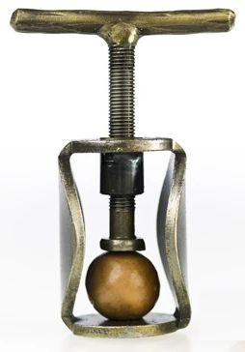
Journal First Presentation
IEEE Transactions on Software Engineering
Compress 20 page paper into 6 minutes
Only concentrate on the interesting aspects .

Slide 3
Background Test Oracle Problem
A test oracle is the mechanism to check whether
execution result = expected outcome
The test oracle may not be available in real-life situations .

Slide 4
Background: Test Oracle Problem Google Search Example
Keyword Search
hotels near "JPMorgan"

Slide 5
Background: Test Oracle Problem Google Search Example
Keyword Search
hotels near "JPMorgan"
Oracle Problem
Is 5M results correct? .

Slide 6
Background Metamorphic Testing
To alleviate the test oracle problem,
verify the consistency between multiple executions,
known as metamorphic relations .

Slide 7
Background: Metamorphic Testing Google Search Example
Metamorphic Relation
Refined keyword search should give fewer results
Refine to
hotels near "JPMorgan Chase"
6M entries
indicating failure in search engine .

Slide 8
Present Research Robustness Testing
Verifies whether a system can deal with erroneous inputs
For example, can Web of Science handle citations with a typo in a hyphen in the paper title?
Test oracle problem because of the big data .

Slide 9
Present Research Metamorphic Robustness Testing
Define metamorphic relations to test consistency between multiple retrievals in citation index system .

Slide 10
Metamorphic Robustness Testing Metamorphic Relation Example
Given large sets of publications without systematic differences,
their mean citation counts should also have little systematic differences .

Slide 11
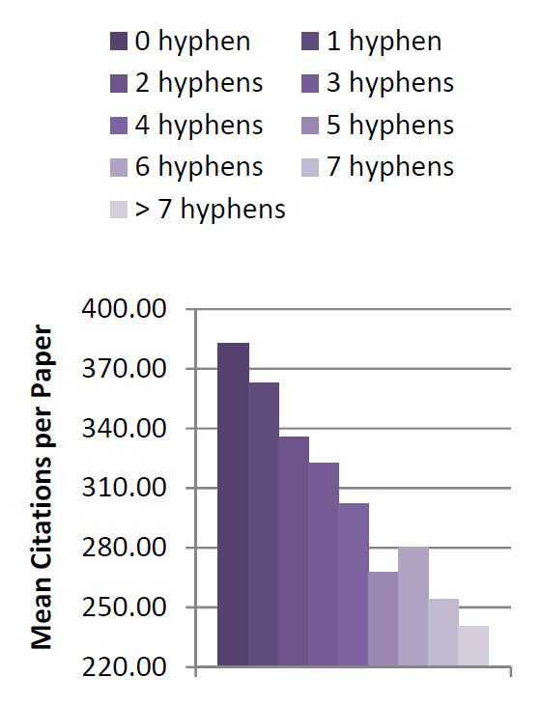
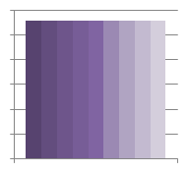
Metamorphic Robustness Testing Metamorphic Relation Example
Expected
Actual
Robustness failure .

Slide 12
Metamorphic Robustness Testing Further Findings
We discovered further failures in citation counts and impact factors at the article, journal, and subject levels

Slide 13
Conclusion Significance
Our result questions the belief that citation counts and journal impact factors are reliable quality measures
⊗

Slide 14
Conclusion Significance
Our result questions the belief that citation counts and journal impact factors are reliable quality measures
⊗
They are distorted simply by hyphens in paper titles .

Slide 15
Conclusion Recognition
Our “bizarre new finding” was reported in numerous international media

Slide 16
Conclusion Controversy
Web of Science Response

Slide 17
Conclusion Controversy
Web of Science Response
Hyphens in article title have no impact on citation counts
Their methodology has been tried and tested over many years
Our Observation
This exactly demonstrates the significance of metamorphic robustness testing in discovering hidden defects .

Slide 18
Your Comments are Welcome

Slide 19
Thank you

