Slide 1

EC-Shuffle: Dynamic Erasure Coding Optimization for Efficient and Reliable Shuffle in Spark
Xin Yao, Cho-Li Wang, Mingzhe Zhang
Department of Computer Science
The University of Hong Kong

Slide 2

Outline
Background
  Basic fault tolerance techniques
  Erasure coding and FTI
  Motivation of EC-Shuffle
Design
  Two EC-based Fault-tolerance Mechanisms
  Dynamic Encoding Selection at Runtime
EC-Shuffle in Spark
Conclusion
Q & A
Notes:
CD CR

Slide 3




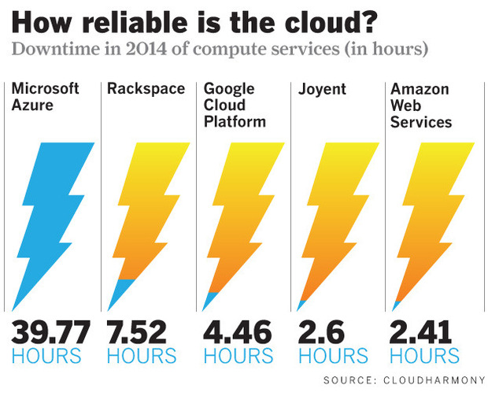
Background
Sources of data loss
  Nodes/Processes crash
  Network partition
  The tail problem: Timeout
Fault-tolerance in current systems
  Storage systems: Storage data/Objects
  Computation systems: Intermediate data at runtime
    Difference: More communication among data partitions (or blocks) in computation systems
Notes:
Fault-tolerance in current systems

Slide 4
General Fault Tolerance Techniques
Machine X
Machine Y
Fault Tolerance Techniques
  Lineage: a list of functions
  Local checkpoints: non-volatile storage
  Replication: Multiple remote copies
Replay
Memory
A
B
B
Replication
network traffic
Disk
checkpoint
B
Recover a program with n wide transformations when r failures happened
 | Storage overhead | Replay cost
Lineage | Few (record operations) | All computation of the program
Local checkpoints | O(n): checkpoint the immediate data of each wide transformation | Only recompute the lost data of each wide transformation, some data partition can be recovered from checkpoints
Replication | O(r): r copies of the last RDD | O(1)
Notes:
Narrow/Wide

Slide 5
Fault-tolerance Mechanism for Shuffle in Spark
Distributed computations
Shuffle runtime
  Default:
    Save the checkpoint of the intermediate shuffle data
    Only recompute the lost data
  RDD.Persist():
    Remote replication
    Checkpoints in HDFS
(1) Map
(2) Aggregation
(3) Partition
(4) Shuffle
Shuffle: the most expensive operations
Notes:
The length of the lineage chain is uncontrollable and the recovery process becomes costly when it contains many wide transform operations
Replications can speed up the recovery procedure but needs much memory space for data duplication and network traffic for synchronization in runtime
Lineage + Local checkpoint
Long recover process
Meta data management (find the parent data)
Storage cost
Ramdisk, wasteful
Hard disk, runtime overhead
Replication
Tolerate K node faults
Easily recover
Timely synchronization
Shortages
Runtime overhead is heavy. Persist() always need to save RDD to the disk or remote machine
Replay transform operations on RDD wastes too much time and memory space. When recovery, the RDD need to read from disk, which causes a long latency.

Slide 6

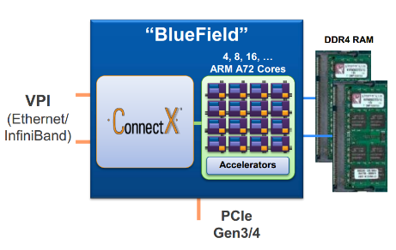
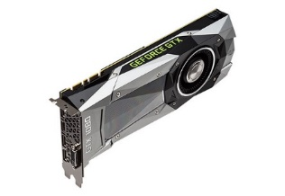


Erasure Coding
Encoding process
  Generate parity chunks
Decoding process
  Deconstruct original data
Advantages:
  Low storage overhead: r/k
  High throughput (Intel report)
RDMA+EC: Mellanox BlueField™ and ConnectX®-5
Encoding Process (k=4, r=2)
Erasure Coding Offloading: GPUs as Storage System Accelerators
Decoding Process (k=4, r=2)
 | Reed Solomon EC (10+4) Throughput per core
Intel Xeon Platinum 8180 Processor | 12.7 GB/s
Intel Xeon Processor E5-2650 v4 | 5.3 GB/s
Intel Xeon Processor E5-2650 v3 | 5.3 GB/s
Intel Xeon Processor D-1541 | 4.6 GB/s
HDFS supports Erasure Coding in Hadoop 3.x
Notes:
Q&A:
You mentioned in the introduction that one core can encode data at 5.3GB/s for Reed-Solomon(10,4) codes. In case of 100Gb/s network, Does it mean that we need an additional core to perform the parity computations for every Map or Reduce instance?
Yes, a mapper or reducer usually has multiple cores.
We can use GPU device or better CPU.
striping an object
the computation overhead is low
https://hadoop.apache.org/docs/r3.0.3/hadoop-project-dist/hadoop-hdfs/HDFSErasureCoding.html

Slide 7
Fault Tolerance Interface
Runtime of FTI
  Divides the system in groups of k processes.
  Generate r parity chunks in each group (k data chunks)
  The highest reliability level (r=k). In most case, we do not need such a high reliability level (r << k)
Recovery
Concerns: network traffic of collecting data chunks in erasure coding is still heavy
Runtime (k=4, r=2)
Recovery
FTI: High performance Fault Tolerance Interface for hybrid systems (SC’11)
Notes:
FTI.

Slide 8
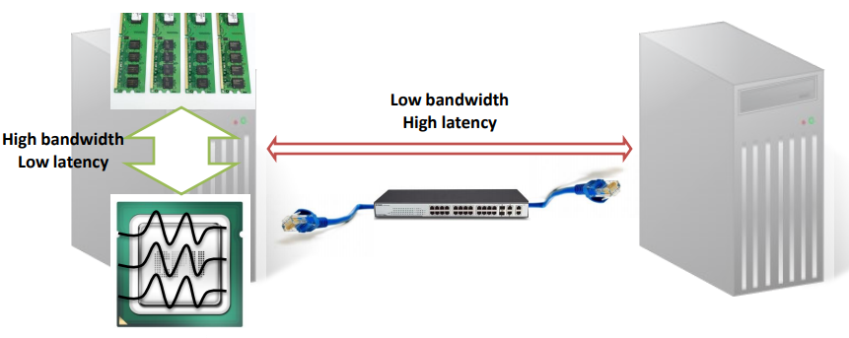
Motivations of EC-Shuffle
Network traffic becomes serious concern
Network bandwidth
  0.1-1GB/s (inter-machine) vs ≥20GB/s (CPU-RAM)
Latency
  10,000-100,000 ns (inter-machine) vs 100 ns (CPU-RAM)
FTI
Network traffic
Remote replication
Local checkpoints
Without FT
Storage/Memory overhead
Notes:
FTI.

Slide 9
Motivations of EC-Shuffle
Two targets of EC-Shuffle:
  Two new encoding schemes to reduce heavy network traffic
    Forward-coding
    Backward-coding
  Reduce the total size of generated parity chunks
    Encoding scheme selection
FTI
Network traffic
Remote replication
EC-Shuffle
Local checkpoints
Without FT
Storage/Memory overhead
Notes:
FTI.

Slide 10
Design -- System Overview
Partition
Aggregation
Difference between EC-Shuffle and FTI:
FTI gather all data at one node before encoding; in EC-Shuffle, each Mapper/Reducer only perform encoding on its own data partition.
FTI has extra data transfer; EC-Shuffle only has parity transfer.
EC-Shuffle could generate a smaller size of parity chunks.
A EC-Shuffle with M mappers and N reducers in Spark,
the reliability level is r.
Notes:
FTI.
striping an object

Slide 11
Design -- Forward-coding Scheme
Pre-shuffle (encoding process)
  For each RDD partition: decide the sub-partitions send to different receivers.
  Compute the parity chunks on each mapper.
Shuffle
  Reducer reads data blocks from mappers
  Parity chunks are send to different nodes/processes
Post-shuffle
  Combine the data chunks from mappers
Memory overhead: r (=2) parity chunks
Extra Network traffic: same with memory overhead
Partition (one-to-N operation), N = 4, r = 2
Notes:
Pre-shuffle
Divide each RDD partition to several sub-partition according to this shuffle operation.
Div(RDD-X) = {Xi}
Locally computing the partition units for each RDD partition and preparing to transfer
computer(Xi) -> PX
Locally EC computing
Low compute cost
No network traffic
Shuffle
Shuffle(PA, PB, PC) = (PX, PY, PZ, PR)
Data units shuffle
same with RDD’s shuffle/wide transform
Parity units collect
parallel with wide transform
network traffic only
total size = one RDD partition
Post-shuffle
Log based update
DAG update (transform logs)
Action update PX
When called persist()
Dynamic add modification to the PR
When another shuffle comes
Come to Pre-shuffle phrase
Discard old data parity

Slide 12
Design -- Forward-coding Scheme
Recovery
  lost data found at the mapper side → fetch the data again remotely
  Else fetch data chunks and parity chunks from other nodes to re-construct the lost data
Network traffic: one chunk (a sub-partition) or four chunks (a RDD partition at the sender).
Notes:
FTI.

Slide 13
Design -- Backward-coding Scheme
Pre-shuffle
  For each RDD partition: decide the sub-partitions send to different receivers.
Shuffle
  Reducer reads data blocks from mappers
Post-shuffle (encoding process)
  Compute the parity chunks on each receiver.
  Combine the data chunks from mappers
  Parity chunks are send to different nodes/processes
Memory overhead: r (=2) parity chunks
Extra Network traffic: same with memory overhead
Aggregation (M-to-one operation), M = 4, r = 2
Notes:
FTI.

Slide 14
Design -- Backward-coding Scheme
Recovery
  data chunks and parity chunks from other nodes to construct the lost data
Network traffic: four chunks (a RDD partition at the receiver).
If an irrecoverable error occurs during the shuffle phase: similar to the replication, RDD will be recovered from the last wide transformation and replay only narrow transformations
Notes:
Q:What was not clear to me (and I wish the authors would address) is that whether reliability is impacted by delaying the parity computation, it leaved more of the overall operations unprotected and/or to be recovered at higher cost by rolling back further the computation stream. Meaning, what would happen if a irrecoverable error occurs during the shuffle phase (e.g. Fig 7c) before the priority is computed and communicated to Node E? This error seems fully covered by scheme in 7a & 7b.
A:Along with the lineage, it can recover the data. The key is that, with EC-Shuffle/Replication. It only need to reply the narrow operation, like map.
For instance, W1->N1->N2->N3->W2.
If using FC, it happens at pre-shuffle phrase, there is no cost in W2, we need to replay W1->N1->N2->N3.
If using BC, it happens at post-shuffle phrase, W2 is finished, we need to replay N1->N2->N3->W2. (Compared to FC, we do not need to replay W1, but W2)
Similar to Replication, the situation is when to replica the RDD

Slide 15
Design -- Dynamic Encoding Strategy
Both Forward-coding and Backward-coding can be used in M-to-N wide transform operation
(M=4, N=2, r=1)
FTI
Network traffic: 8 data chunks
Parity chunks: 2 parity chunks
Forward-coding
Network traffic: 4 parity chunks
Parity chunks: 4 parity chunks
Backward-coding
Network traffic: 2 data chunks
Parity chunks: 2 data chunks
Notes:
FTI.

Slide 16
Design -- Dynamic Encoding Strategy
Both Forward-coding and Backward-coding can be used in M-to-N wide transform operation
(M=2, N=4, r=1)
FTI
Network traffic: 8 data chunks
Parity chunks: 4 parity chunks
Forward-coding
Network traffic: 2 parity chunks
Parity chunks: 2 parity chunks
Backward-coding
Network traffic: 4 parity chunks
Parity chunks: 4 parity chunks
Notes:
FTI.

Slide 17
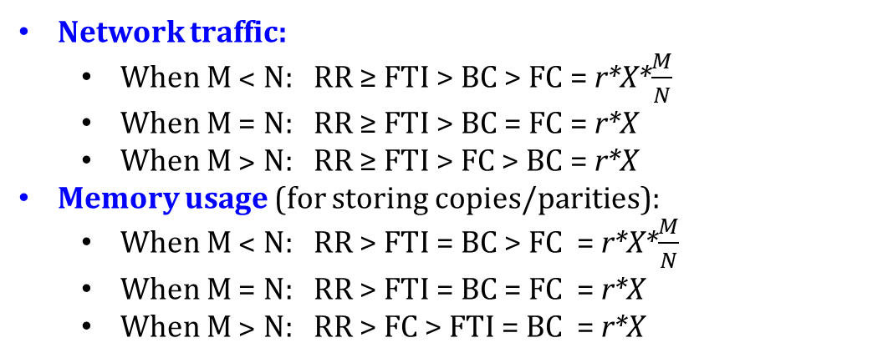
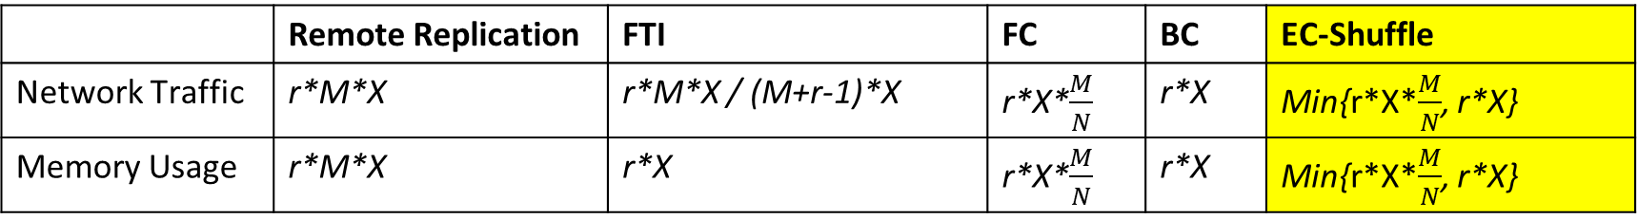
Design -- Dynamic Encoding Strategy
Overhead comparison
 | Remote Replication | FTI | FC | BC | EC-Shuffle
Network Traffic | r*M*X | r*M*X / (M+r-1)*X | r*X*$\frac{M}{N}$ | r*X | Min{r*X*$\frac{M}{N}$, r*X}
Memory Usage | r*M*X | r*X | r*X*$\frac{M}{N}$ | r*X | Min{r*X*$\frac{M}{N}$, r*X}
Network traffic:
  When M ˂ N: RR ≥ FTI > BC > FC = r*X*$\frac{M}{N}$
  When M = N: RR ≥ FTI > BC = FC = r*X
  When M ˃ N: RR ≥ FTI > FC > BC = r*X
Memory usage (for storing copies/parities):
  When M ˂ N: RR > FTI = BC > FC = r*X*$\frac{M}{N}$
  When M = N: RR > FTI = BC = FC = r*X
  When M ˃ N: RR > FC > FTI = BC = r*X
Notation
M | The number of mappers/senders
N | The number of reducers/receivers
X | The size of data partition in each mapper/sender
r | The reliability level
Notes:
FTI.

Slide 18
Implementation Challenges
(1) Large numbers of mappers and reducers in the shuffle :
  Cause long delay when recover the lost data by decoding many chunks.
  Divide N/M data chunks into several groups, each group has k data chunks and generates r parity chunks.
(2) Data Chunks in Different Lengths:
  Append a zero-byte array to each short chunks
  Light overhead in most applications
Notes:
I was not able to understand how do you decide where to send the parity chunks? Is this left to SPARK?

Slide 19
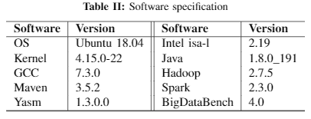
Experiments
Hardware:
  A spark cluster with 64 physical nodes
  1Gb/s Ethernet
Spark configurations
Intelligent Storage Acceleration Library
  Reed-Solomon code
  ISAL-Java-SDK (implemented via JNI)
Benchmark: BigDataBench 4.0
  Network-intensive: Sort, PageRank
  Computing-intensive: Matrix Multiply
The performance of ISAL-Java-SDK in our cluster
Intel Xeon CPU E5540 | Encoding speed | Decoding speed
10 + 1 | 2.56 GB/s | 4.28 GB/s
10 + 4 | 1.31 GB/s | 1.57 GB/s
Notes:
https://github.com/yangqiang/BigDataBench-Spark
Intel Xeon CPU E5-2609 v3
Encoding speed
Decoding speed
10 + 1
5.50 GB/s
5.55 GB/s
10 + 4
2.27 GB/s
2.23 GB/s

Slide 20
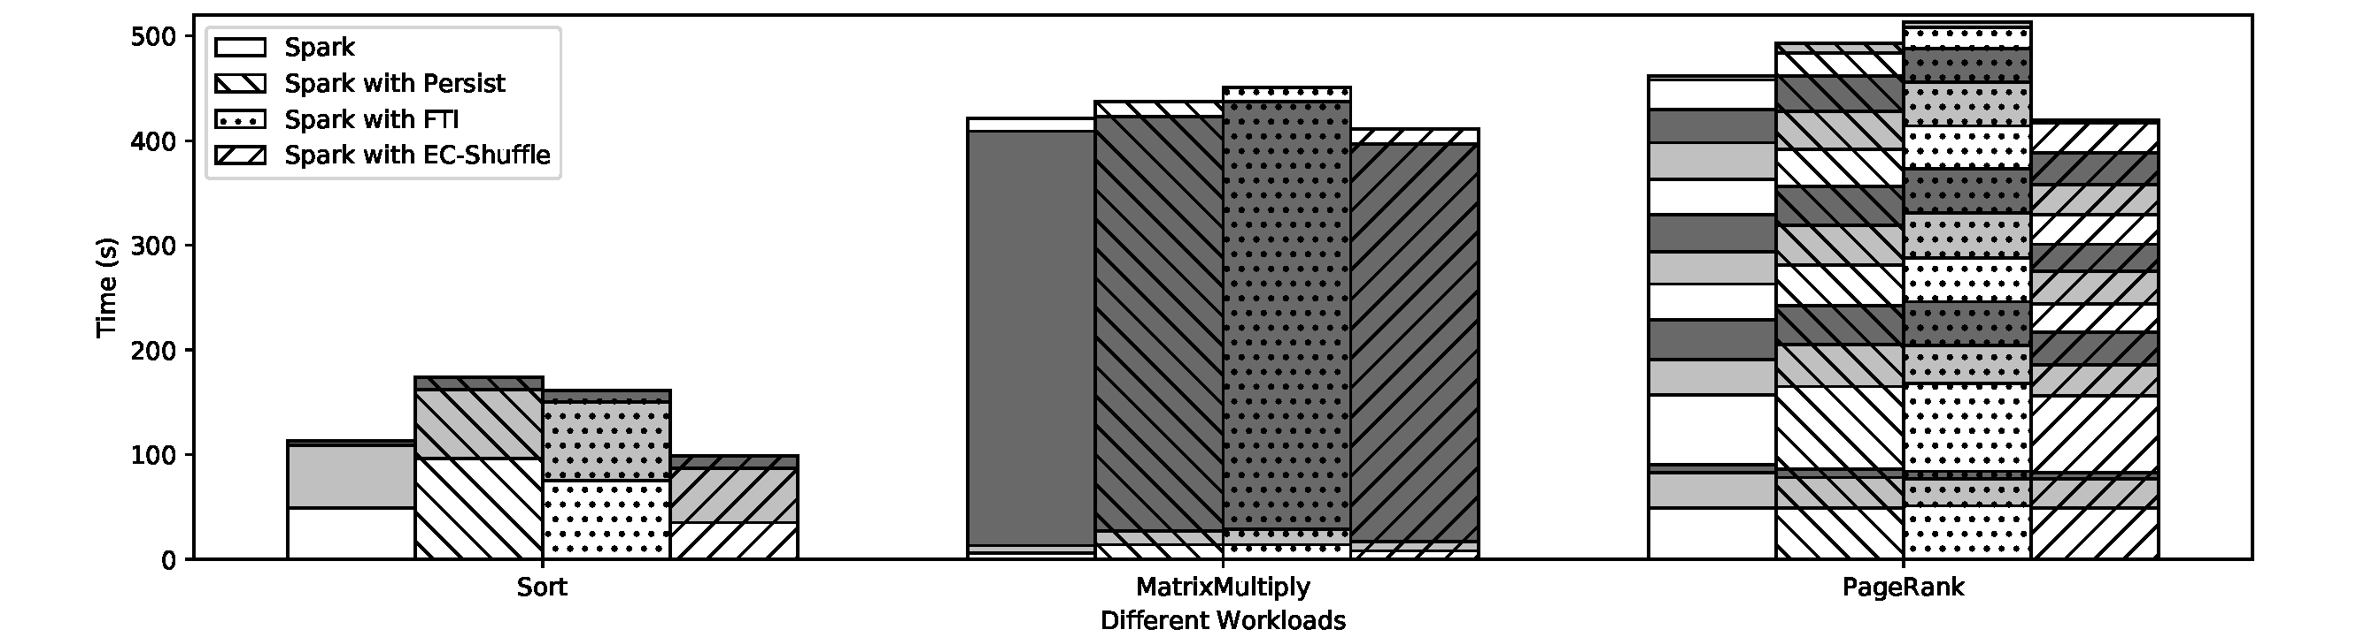
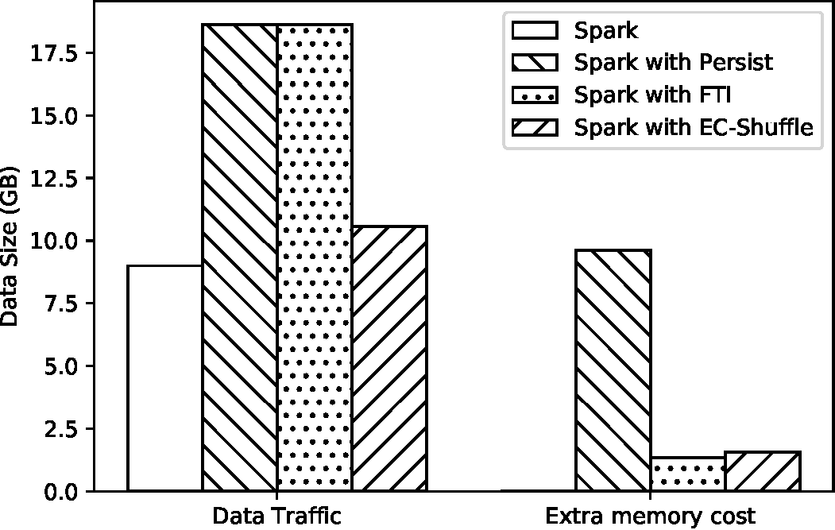
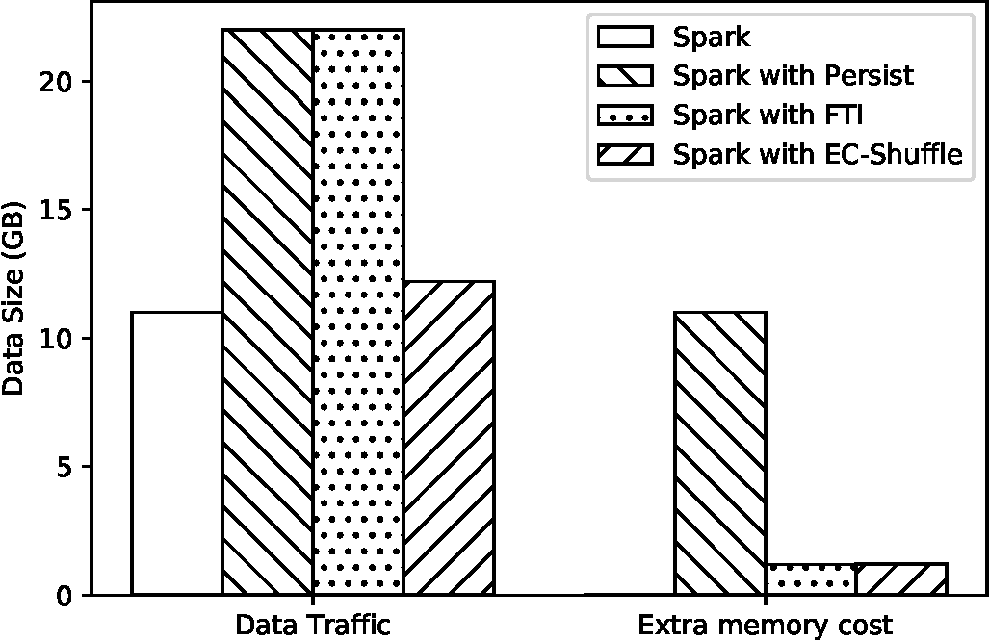
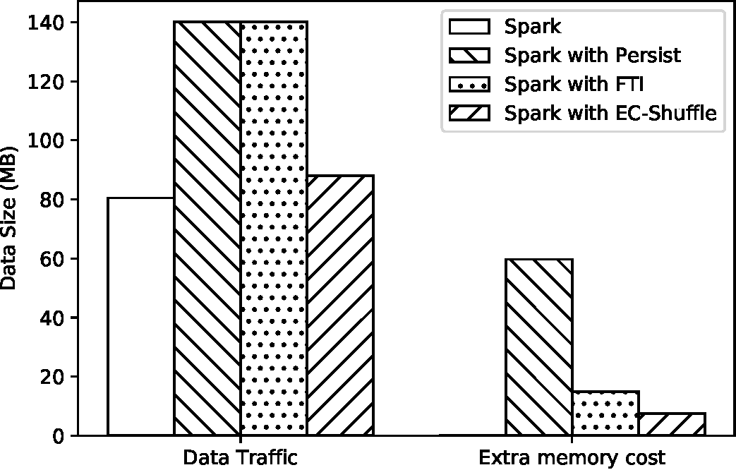
Evaluation -- Different Workload Types
9%
18%
43%
43%
45%
37%
84%
89.1%
75%
50%
Sort
(M=N=96)
Matrix Multiply
(M=N=200)
PageRank
(M=4, N=8)
Notes:
Spark UI translate to GB by dividing (1000 * 1000 * 1000) – (Show Shuffle traffic)
RDD partition and Parity chunks are output in log, show the byte size
spark.shuffle.file.buffer

Slide 21
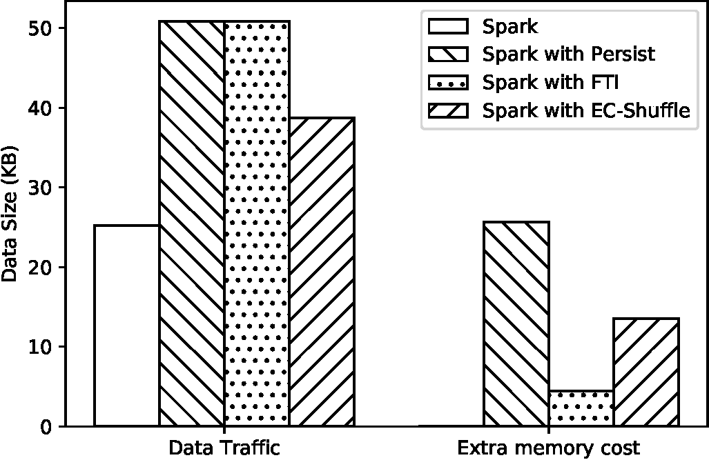
Evaluation -- Different Workload Types
With EC-Shuffle, the network-intensive workloads has more performance improvement than the computing-intensive workloads.
  a shuffle has heavy network traffic, but with few computation workloads
  more shuffle operation
Load balance is important to determine the total size of parity chunks.
  Align data chunks, larger parity chunks
(Limitation) Erasure coding performs not well on encoding data chunks in small size.
  KMeans and SVMWithSGD
KMeans
Notes:
Spark UI translate to GB by dividing (1000 * 1000 * 1000) – (Show Shuffle traffic)
RDD partition and Parity chunks are output in log, show the byte size

Slide 22
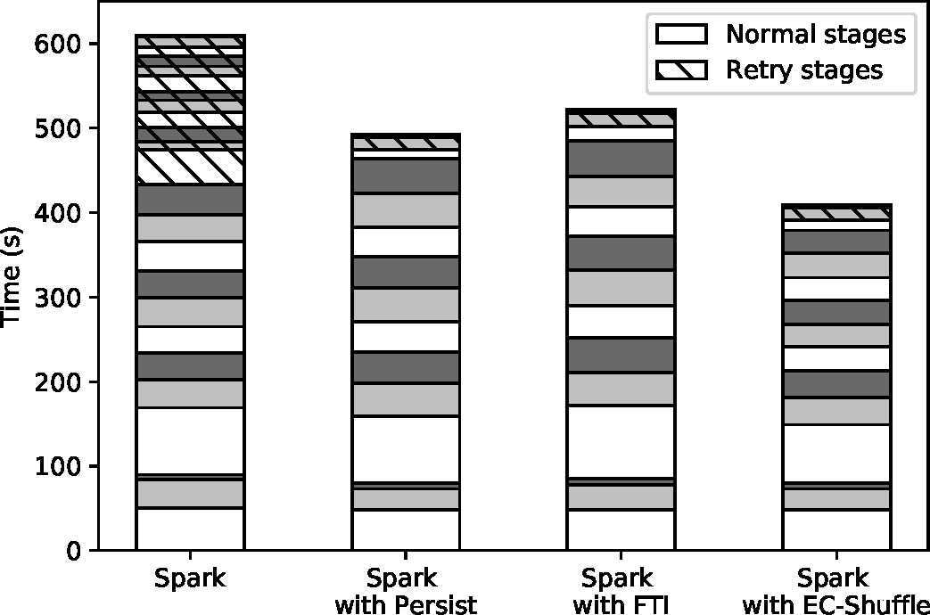
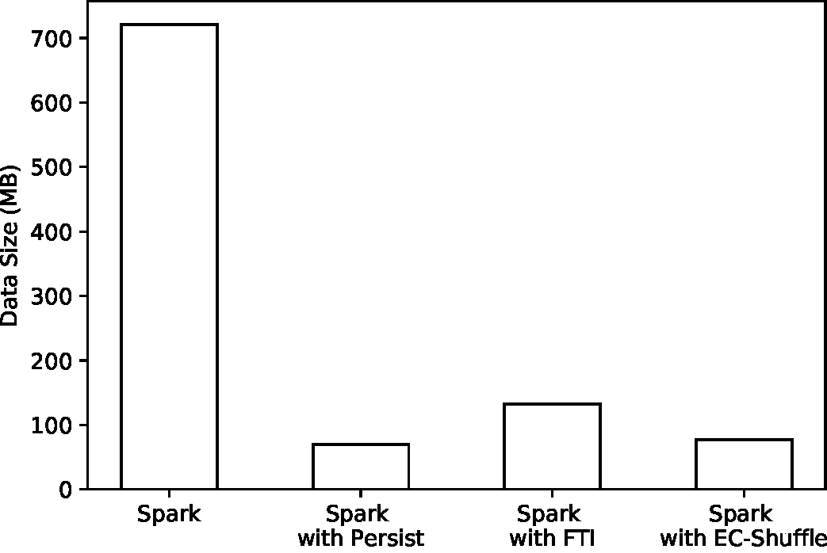
Evaluation -- Recovery
Application: PageRank for 10 iterations
  M = 4, N = 8
Replication/ FTI/ EC-Shuffle can instantly recover the runtime data (only one retry stage)
  FTI needs 4 RDD partition to recover the lost data
Notes:
Spark UI translate to GB by dividing (1000 * 1000 * 1000) – (Show Shuffle traffic)
RDD partition and Parity chunks are output in log, show the byte size

Slide 23
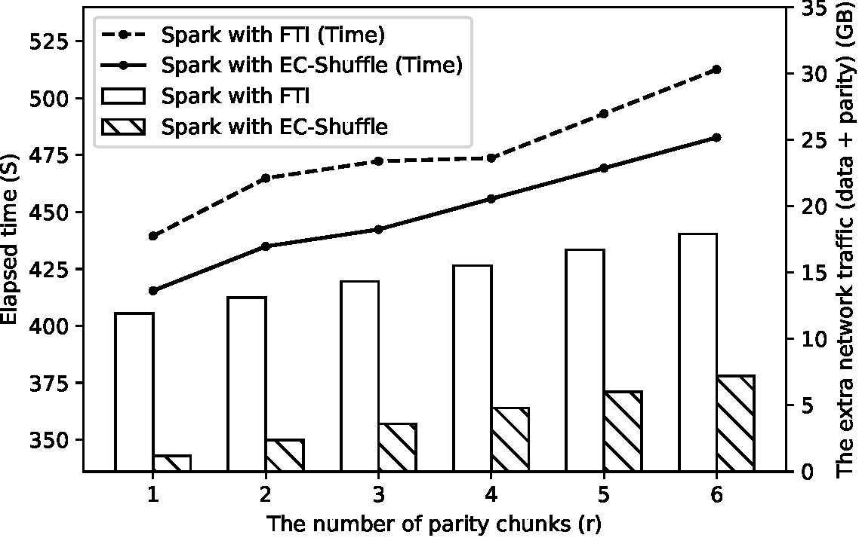
Evaluation -- Different Reliability Levels
Application: MatrixMultiply
  M = N = 200
Traffic:
  FTI: a full RDD + (r-1) parity chunks
  EC-Shuffle: r parity chunks
Computation
  With the same speed, encoding big data chunks cause a longer time
The generated parity data size in FTI and EC-Shuffle

Slide 24
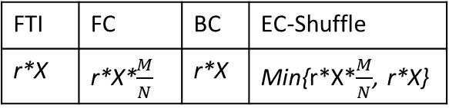
Evaluation -- Dynamic Encoding Strategy
The generated parity data size in FTI and EC-Shuffle
FTI | FC | BC | EC-Shuffle
r*X | r*X*$\frac{M}{N}$ | r*X | Min{r*X*$\frac{M}{N}$, r*X}
M, N | 2 | 4 | 8 | 16 | 32 | 64
2 | 1:1.008:1.000 | 1:0.542 | 1:0.290 | 1:0.294 | 1:0.298 | 1:0.199
4 | 1:1.006 | 1:1.077:1.012 | 1:0.593 | 1:0.608 | 1:0.676 | 1:0.551
8 | 1:1.014 | 1:1.030 | 1:1.074:1.055 | 1:1.139:1.078 | 1:1.263:1.022 | 1:1.134:1.078
16 | 1:1.022 | 1:1.039 | 1:1.049 | 1:1.250:1.076 | 1:1.330:1.114 | 1:1.259:1.161
32 | 1:1.025 | 1:1.046 | 1:1.067 | 1:1.233:1.098 | 1:1.393:1.145 | 1:1.289:1.210
Findings:
  When M ˂ N: Forward-coding save up to 80%
  When M = N: The same
  When M ˃ N: backward-coding
Limitations:
  Imbalanced workloads
  the group size k (10) -> 8 or 16

Slide 25
Limitation
(1) Load imbalance:
  - Combine with other works (try to balance the workloads)
  - Data chunks in different sizes: append zero-valued bytes to data
  chunks for calculating the parity chunks
  - Multi-Phrase encoding: it avoids allocating zero-valued bytes
  but it will cause new concern to encode data chunks in small size.
(2) Small-size shuffle block:
- EC is less efficient in encoding data chunks of small sizes
Notes:
The authors mentioned "all data chunks should be in the same size. In real applications, those data chunks are usually different in sizes (i.e., load imbalance). FTI solves this issue by dividing these data chunks into 4KB blocks. However, in Spark, this solution brings significant overhead (e.g., metadata) to manage these blocks. We find the data chunk whose size is the largest among k data chunks. we append an array of zero-valued bytes to each data chunk.". How do the authors deal with the zeros in the calculations, do they add them only in calculating the parity chunks? If you are deleting the zeros after the parity calculations. What is the effect of adding and deleting the zeros on the garbage collector? Would you suggest any other solution than the zeros bytes
How would the performance look like with higher r? ( r =2 and r = 3 ). What is the computational overhead of increasing the replication factor?
Could you please show how high are the reconstruction costs when one or more chunks are lost.

Slide 26
Future Work
(1) Streaming Computing widely use the uncoordinated checkpointing technique, e.g., Flink.
- FTI needs synchronization among k processes to collect their data chunks.
- In EC-Shuffle, each process encode its data chunks independently.
(2) Operations in irregular communication pattern:
=
+
+

Slide 27
Conclusion
 EC-Shuffle only transfers the parity chunks to provide fault-tolerance.
 EC-Shuffle executes coding processes in parallel at multiple mappers/receivers.
● EC-Shuffle presents dynamic encoding strategies, which can generate the minimum size of parity chunks. It outperforms FTI by reducing up to 80% of the total size of the parity chunks.

Slide 28
THANK YOU
Q & A

